Slide 1
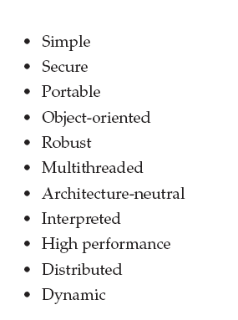
Good points of Java
Prepared By Bal Krishna Subedi

Slide 2
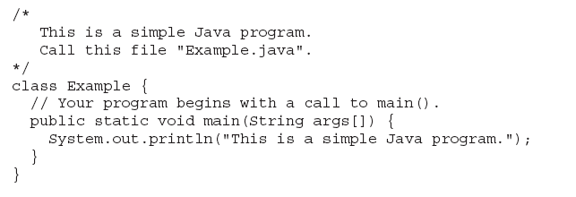
Sample Java Program
Prepared By Bal Krishna Subedi

Slide 3



Compile & Run of Program
Prepared By Bal Krishna Subedi

Slide 4
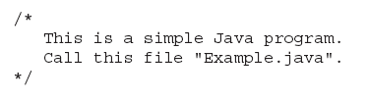

Comment in Java
Prepared By Bal Krishna Subedi

Slide 5
Main() Method
A main class is a class that contains a main method. This class acts as the entry point for a Java application (i.e., its main method will be where the Java code begins its execution). A main class can have any name although typically it will just be called "Main".
Prepared By Bal Krishna Subedi

Slide 6
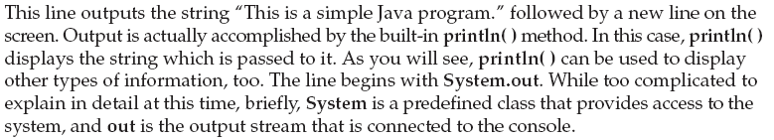
Input/output statement (Example)
Prepared By Bal Krishna Subedi

Slide 7
Basic Elements In Java
Prepared By Bal Krishna Subedi

Slide 8
Lexical Issues
White Space
Identifier
Keyword
Separators
Literal
Prepared By Bal Krishna Subedi

Slide 9
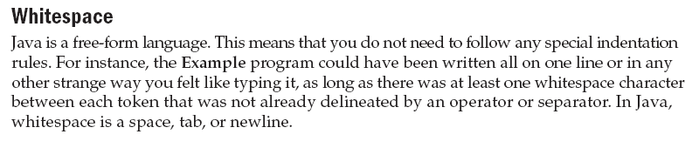
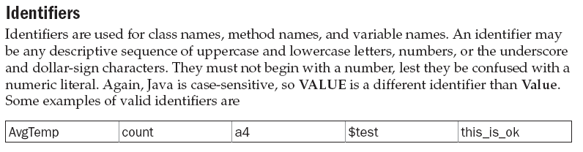
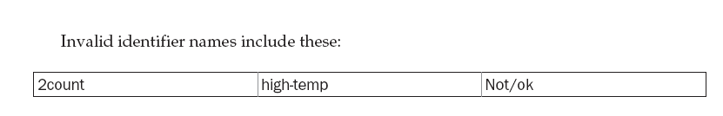
Prepared By Bal Krishna Subedi

Slide 10
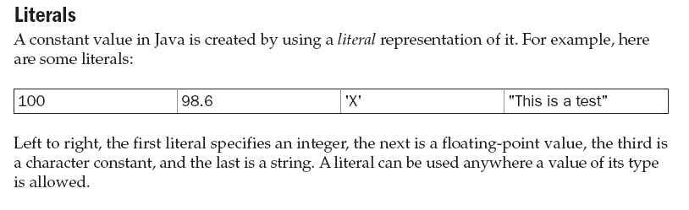
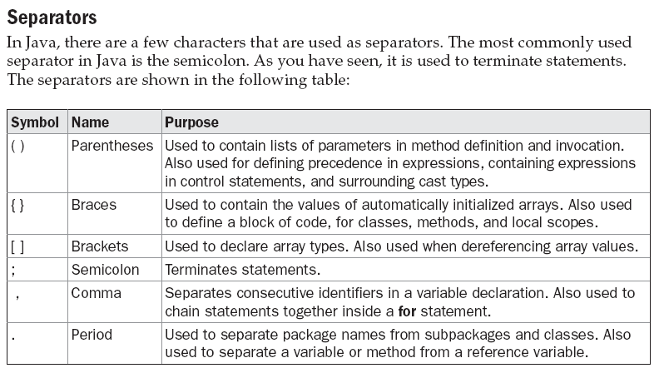
Prepared By Bal Krishna Subedi

Slide 11
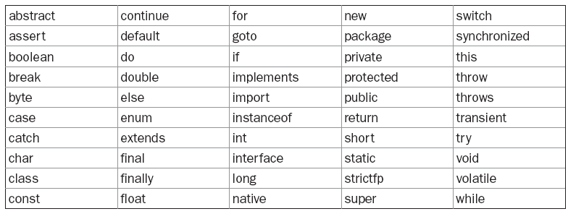
Keywords
Prepared By Bal Krishna Subedi

Slide 12
Data types, Variables & Arrays
Primitive Data types
Integer type
Floating- points type
Characters
Booleans
Prepared By Bal Krishna Subedi

Slide 13
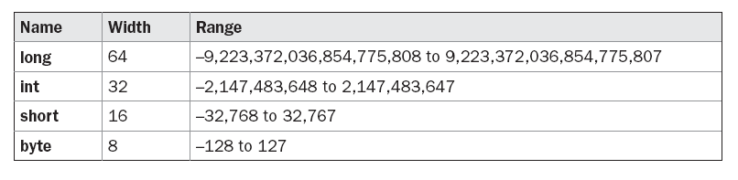
Integer
Prepared By Bal Krishna Subedi

Slide 14
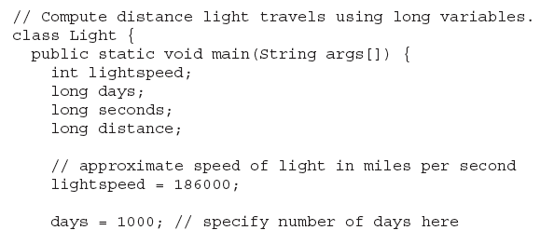
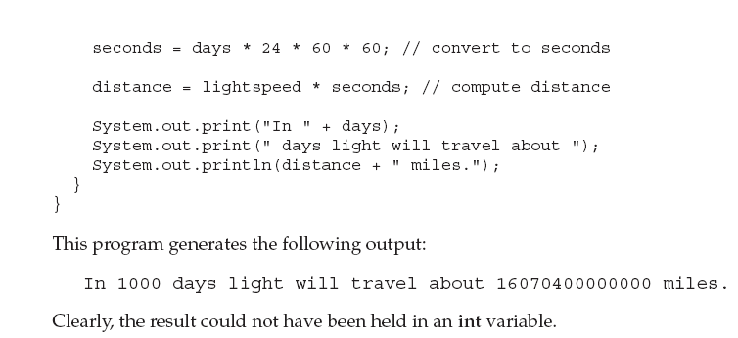
Prepared By Bal Krishna Subedi

Slide 15
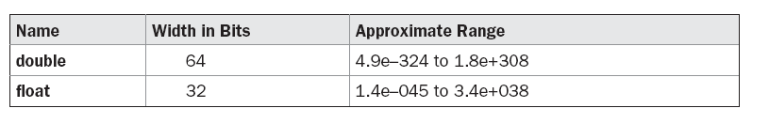
Floating points types
Prepared By Bal Krishna Subedi

Slide 16
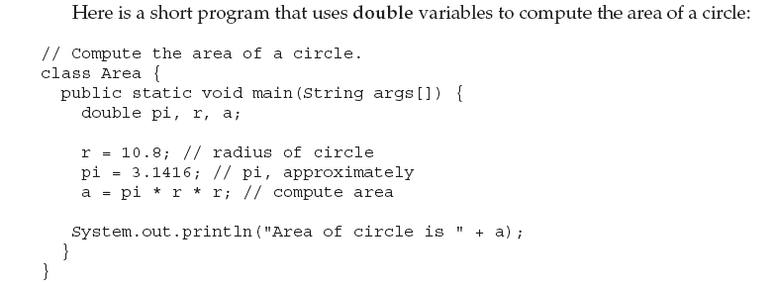
Example of Floating Point types program
Prepared By Bal Krishna Subedi

Slide 17
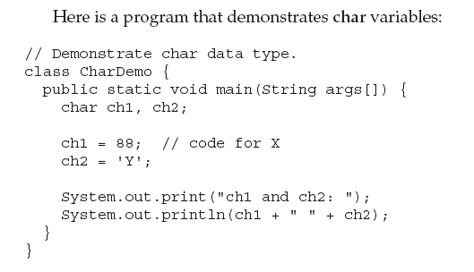
Characters & it’s Example
Prepared By Bal Krishna Subedi

Slide 18
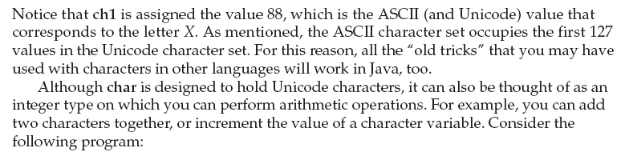
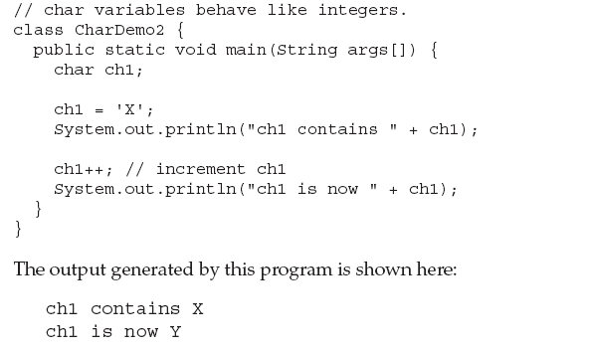
Prepared By Bal Krishna Subedi

Slide 19
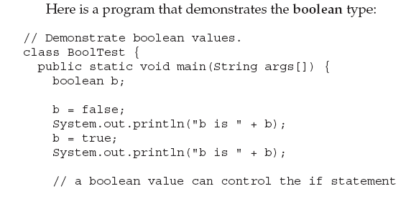
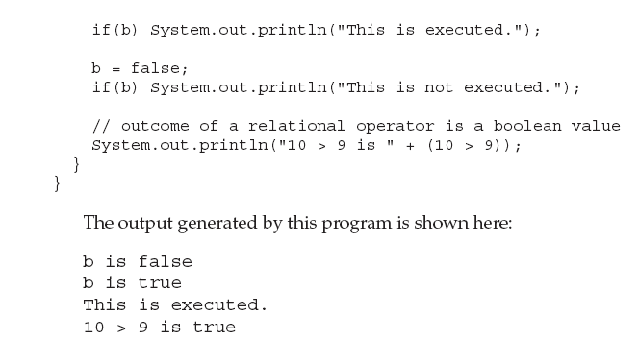
Booleans & it’s Example
Prepared By Bal Krishna Subedi

Slide 20
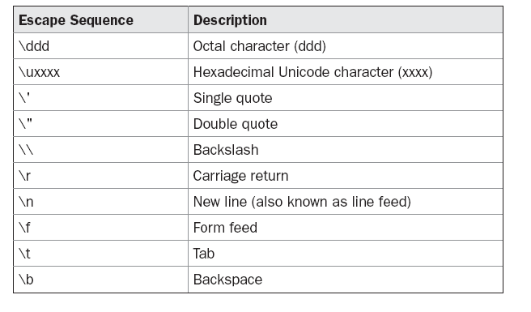
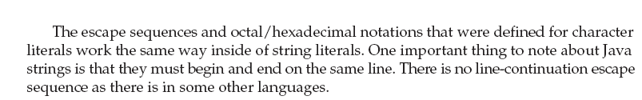
Escape Sequence
Prepared By Bal Krishna Subedi

Slide 21
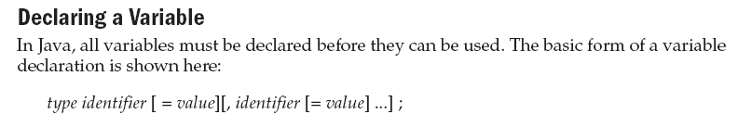
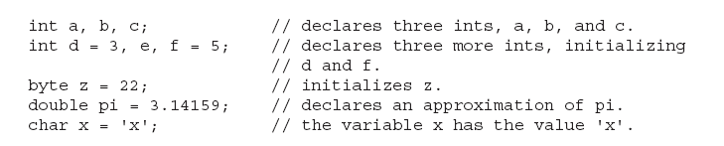
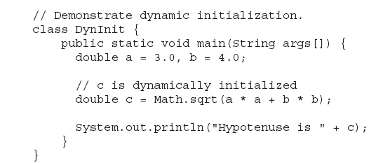
Variable & it’s Declaration
Prepared By Bal Krishna Subedi

Slide 22
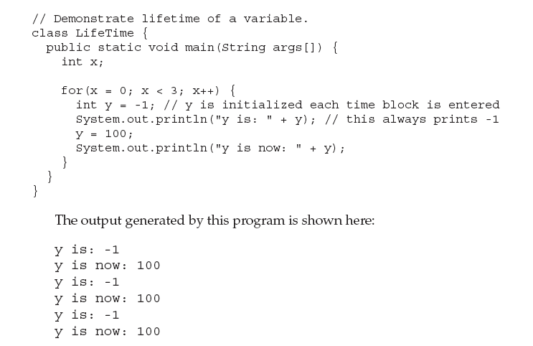
Scope & Life Time of Variable
Prepared By Bal Krishna Subedi

Slide 23
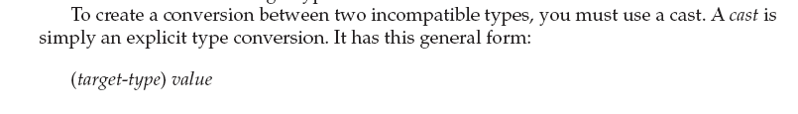
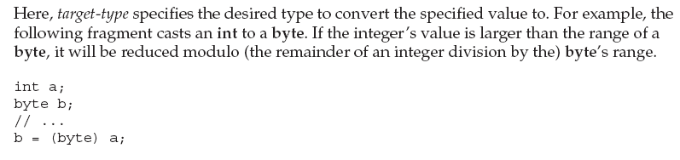
Type Conversion and Casting
Prepared By Bal Krishna Subedi

Slide 24
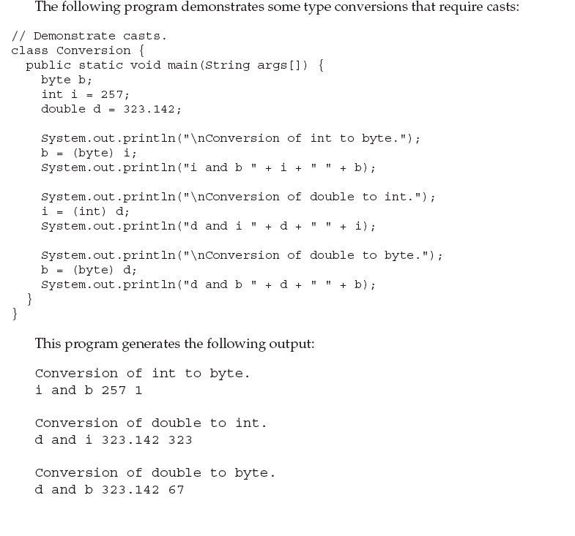
Prepared By Bal Krishna Subedi

Slide 25

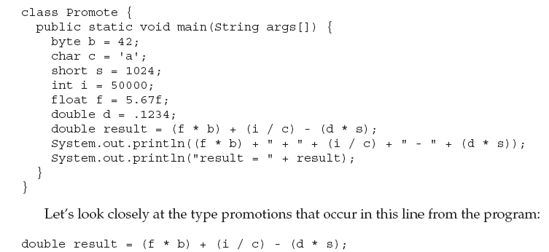
Type Promotion Expression & it’s Rules
Prepared By Bal Krishna Subedi

Slide 26

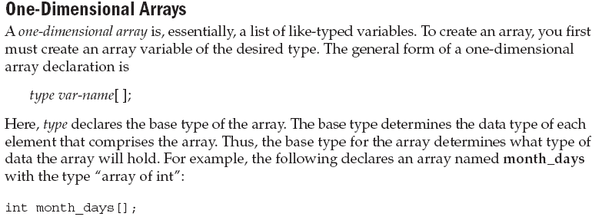
Arrays
Prepared By Bal Krishna Subedi

Slide 27



Allocation of Array
Syntax
Example
Initialization of array values
Prepared By Bal Krishna Subedi

Slide 28
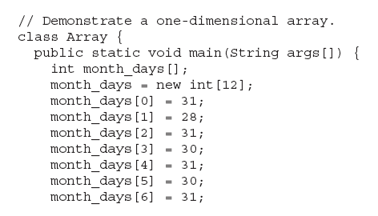
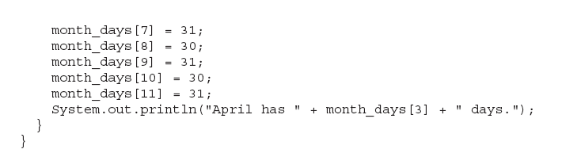
Example of Array’s Program
Prepared By Bal Krishna Subedi

Slide 29
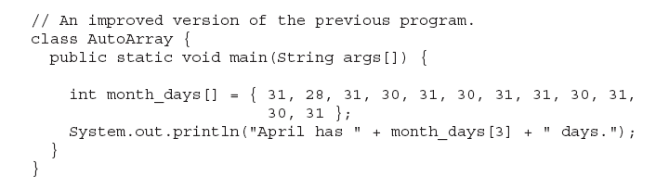
Example
Prepared By Bal Krishna Subedi

Slide 30
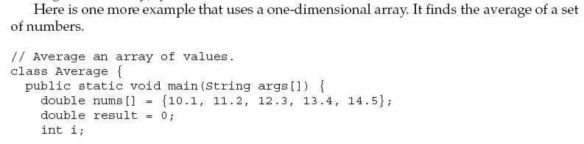
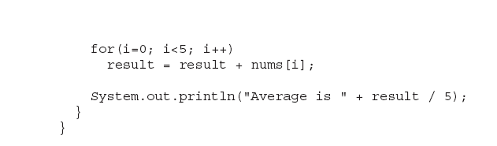
Prepared By Bal Krishna Subedi

Slide 31
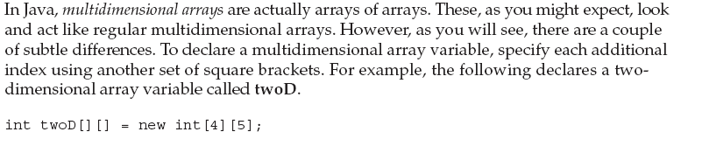
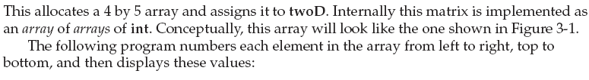
Multi Dimensional Arrays
Prepared By Bal Krishna Subedi

Slide 32
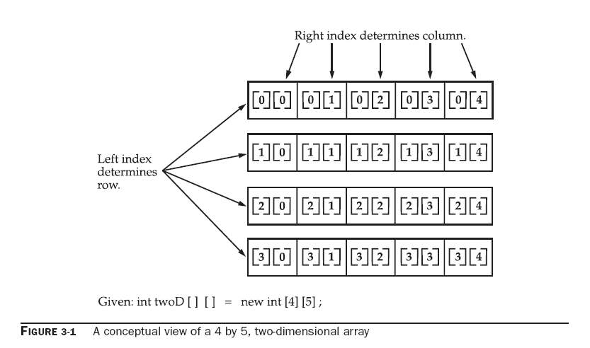
Prepared By Bal Krishna Subedi

Slide 33
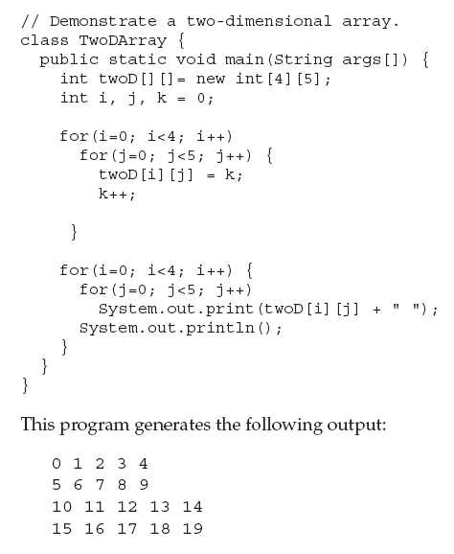
Prepared By Bal Krishna Subedi

Slide 34
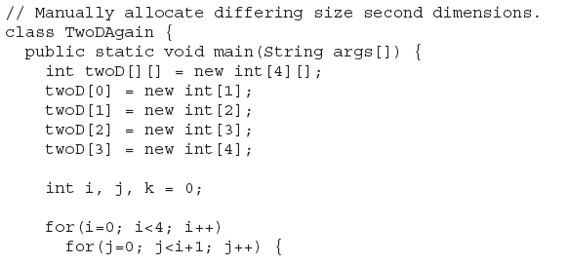
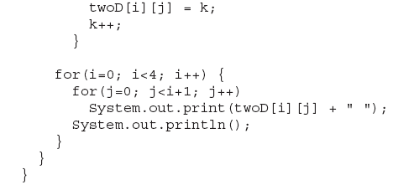
Examples of 2D Arrays
Prepared By Bal Krishna Subedi

Slide 35
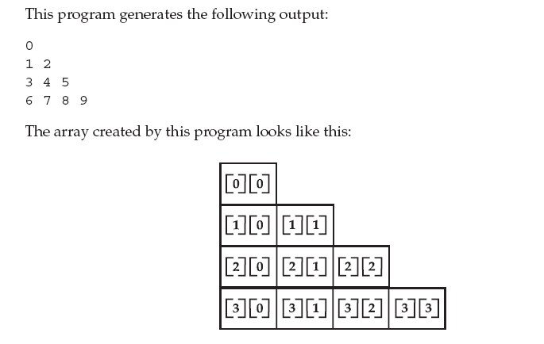
Prepared By Bal Krishna Subedi

Slide 36
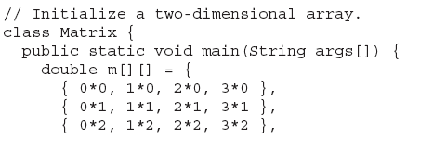
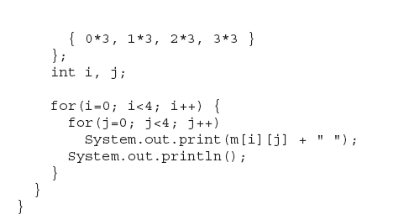
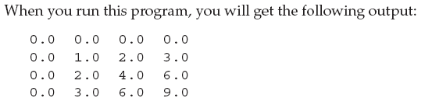
Prepared By Bal Krishna Subedi

Slide 37
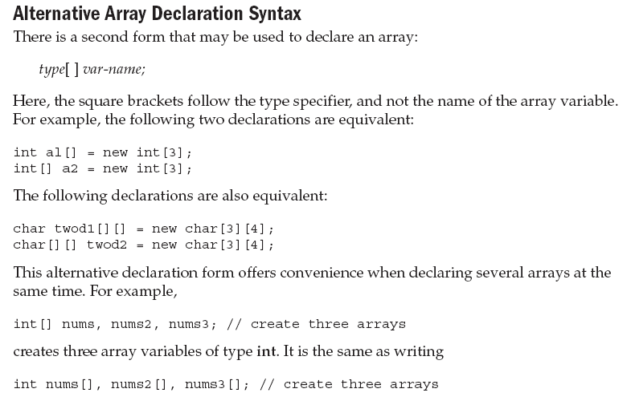
Prepared By Bal Krishna Subedi

Slide 38
Lab Assignment
Write a java program to find largest numbers in given list of array.
Write a java program to find sum of any two matrix.
Write a program to display as
1
2
1 2 3
1 2 3 4
Prepared By Bal Krishna Subedi

Slide 39
Thanks You
Any Queries??
Prepared By Bal Krishna Subedi

